Slide 1
Student Adds Schools to FAFSA® Form

Slide 2
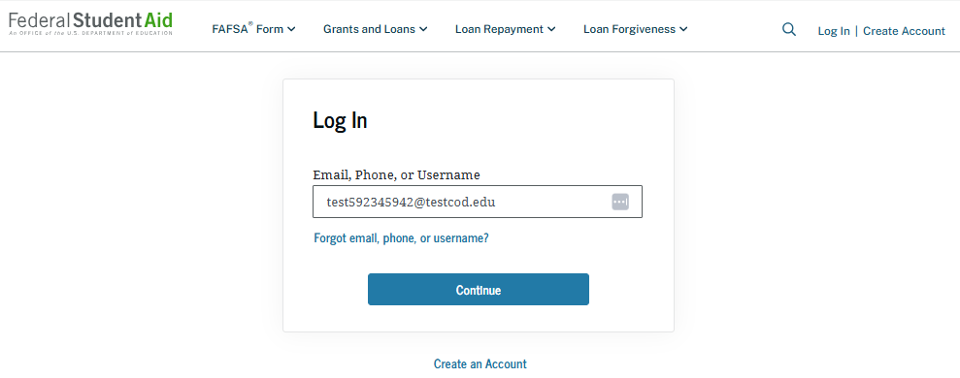
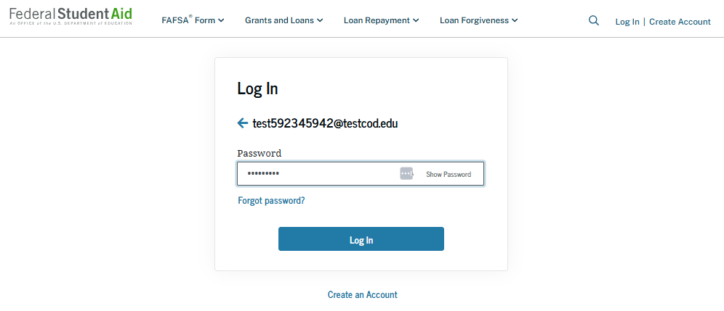
Add Schools: Log-in
To access an existing FAFSA® form, the student must have a StudentAid.gov account username and password.

Slide 3
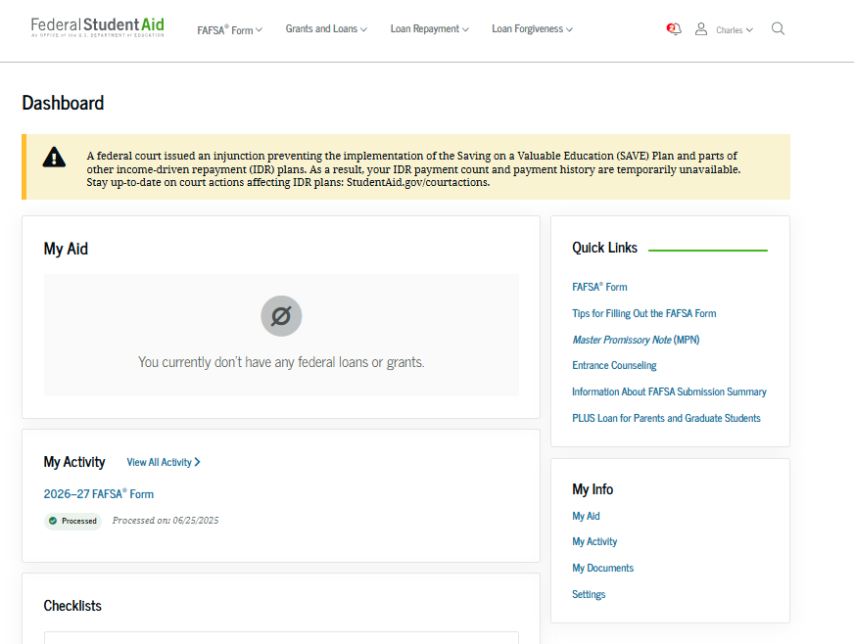
Add Schools: Dashboard
On the account Dashboard, the student can see their most recent 2026–27 FAFSA® activity under the "My Activity" section. In this scenario, the student has a processed 2026–27 FAFSA form. To see further information about this application, the student selects the application and is taken to the "Details" page.

Slide 4
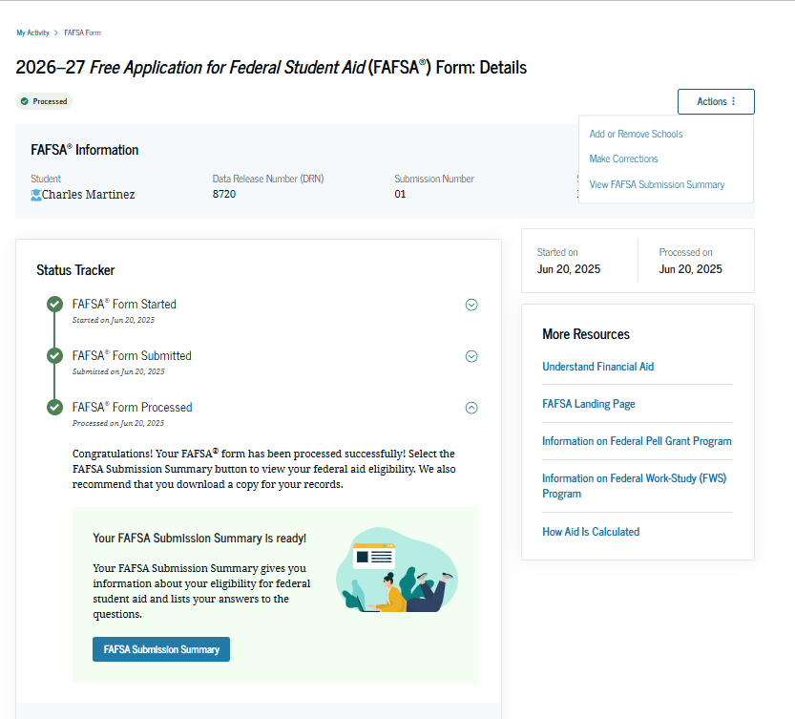
Add Schools: Details
On the "Details" page, the student sees information related to their processed FAFSA® form (such as when it was started and processed), their FAFSA Submission Summary, and additional resources. Within the "Actions" menu, the student can select "Add or Remove Schools." Selecting this option will start a voluntary correction to update the selected schools.

Slide 5
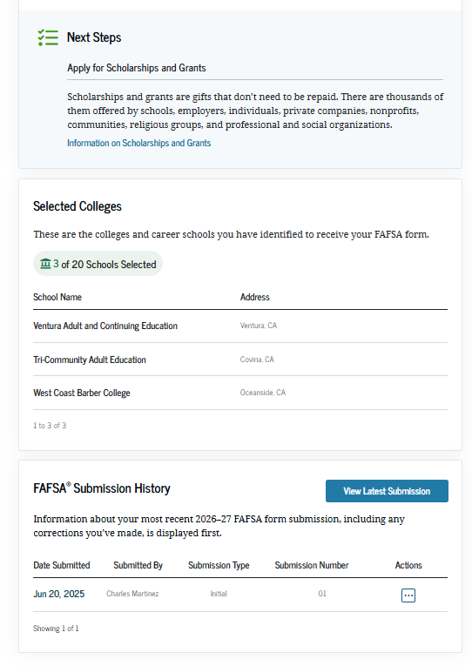
Add Schools: Details (Continued)
Farther down the "Details" page, the student sees their invited contributor(s), selected school(s) and FAFSA® submission history. In this scenario, the student selects "Add or Remove Schools" within the "Actions" menu to update the selected schools.

Slide 6
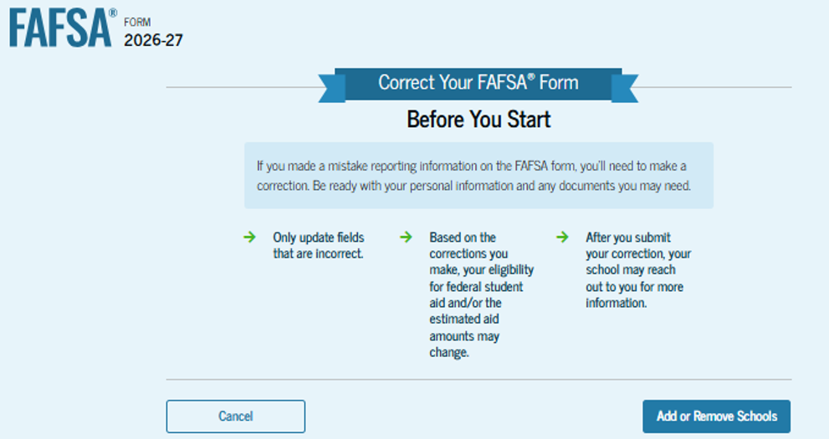
Add Schools: Onboarding
When the student starts a 2026–27 FAFSA® correction, they are taken through the FAFSA correction onboarding process. A correction should only be submitted if critical information was missing, the form contains incorrect information, the student needs to update the selected school(s), and/or a financial aid administrator requested a correction. The student selects "Add or Remove Schools" to begin the correction.

Slide 7
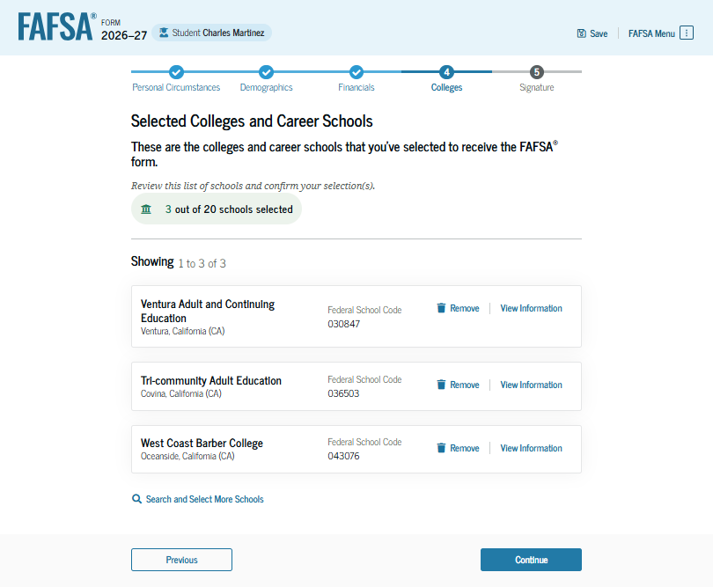
Add Schools: Selected Colleges and Career Schools
The student can view which college(s), career school(s), and/or trade school(s) they selected in their processed application. If the student has not selected 20 schools, they have the option to search and select more schools, and, in some states, the student has the option to reorder the list of selected schools. In this scenario, the student wants to remove a previously selected school and add new ones. The student selects "Remove" for the listed school(s).

Slide 8
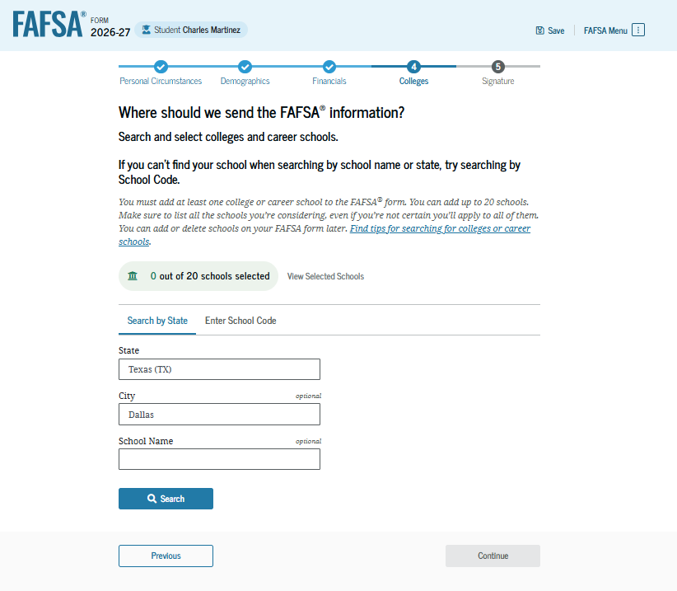
Add Schools: College Search
After removing the school(s), the student selects "Search and Select More Schools" on the previous page and is taken to the “Colleges” search page. The student is asked to search for the college(s), career school(s), and/or trade school(s) they would like to receive the student’s FAFSA® information. The student searches for a school by entering a state and a city and/or school name.

Slide 9
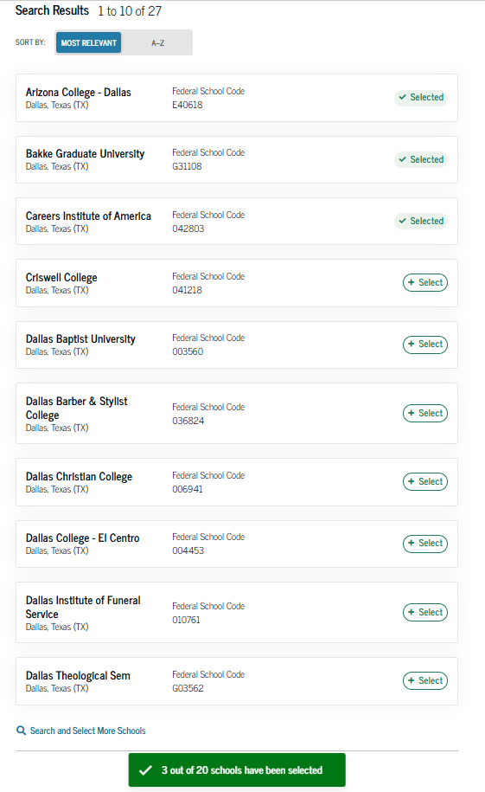
Add Schools: College Search (Continued)
After entering a school’s state and city and/or school name and selecting "Search," the student selects the correct school(s) from the search results. Students can send their FAFSA® information to a maximum of 20 schools.

Slide 10
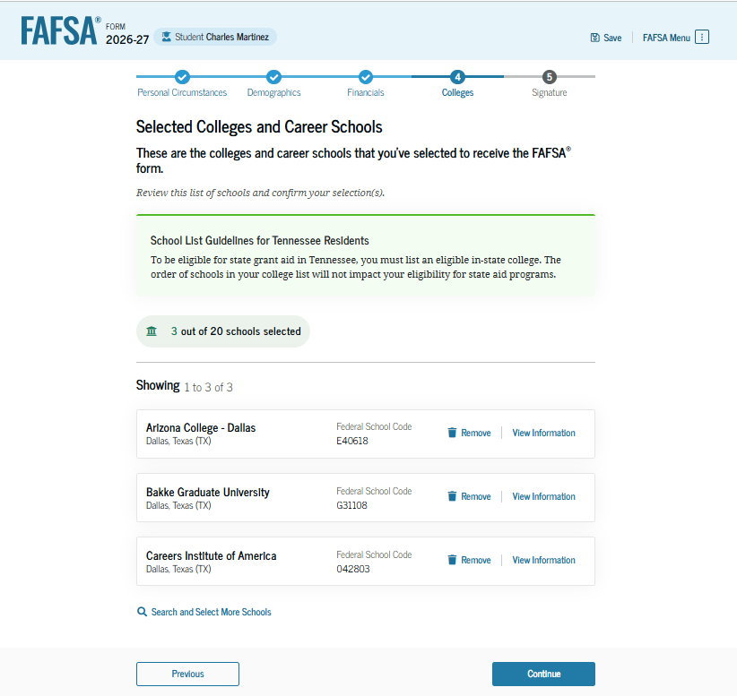
Add Schools: Review Selected Schools
The student can view which new college(s), career school(s), and/or trade school(s) they’ve selected. When the student selects "Continue," the updates to the "Selected Colleges and Career Schools" section will be complete, and the student can proceed to the review changes page.

Slide 11
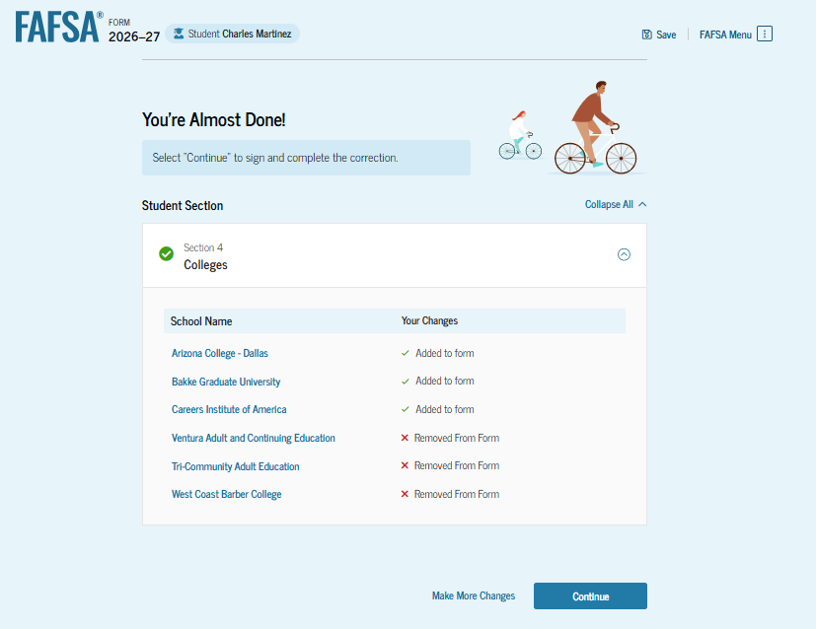
Add Schools: Review Changes Page
The review page displays the school(s) that the student has added and/or removed. If the student needs to make additional updates to the rest of the FAFSA® form, they can select "Make More Changes." In this scenario, the student is ready to submit the correction and selects "Continue."

Slide 12
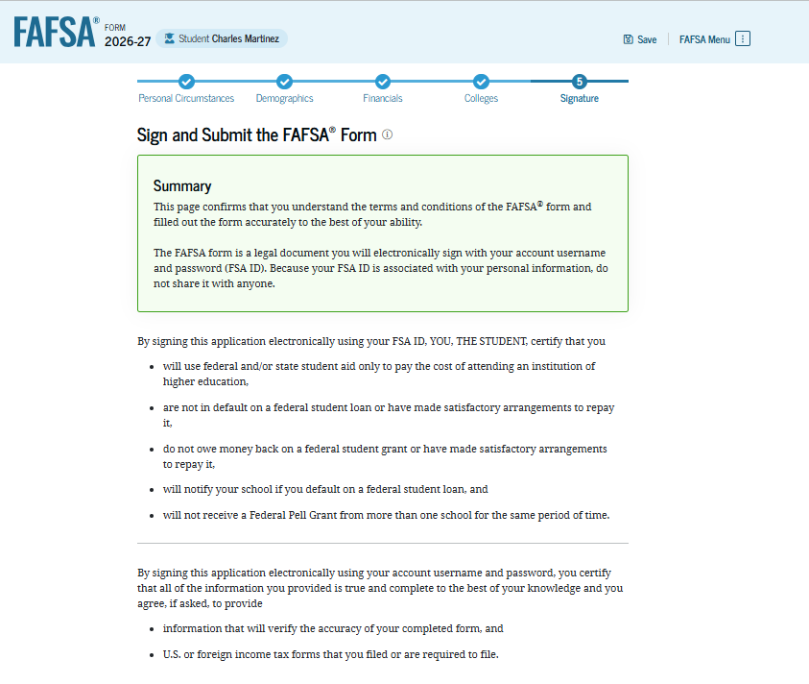
Add Schools: Sign and Submit Changes to the FAFSA® Form
On this page, the student reviews the terms and conditions of the FAFSA® form and what they’ll agree to by digitally signing the form.

Slide 13
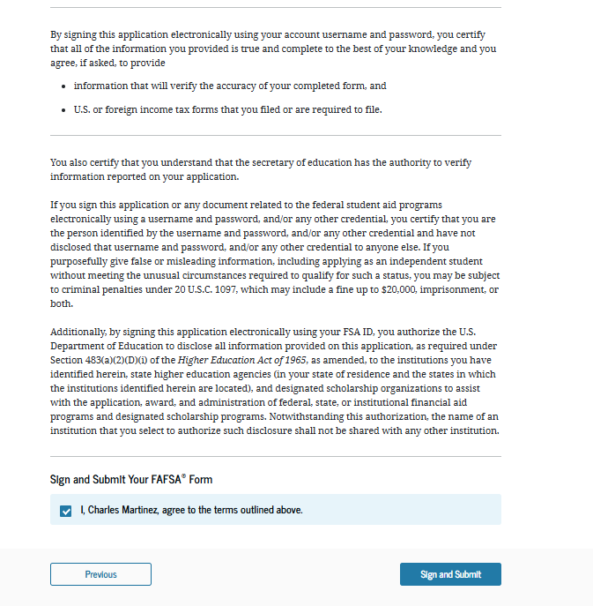
Add Schools: Sign and Submit Changes to the FAFSA® Form (Continued)
This is a continuation of the student signature page. After agreeing to the terms and conditions of the FAFSA® form and digitally signing, the student can resubmit their section of the FAFSA form.

Slide 14
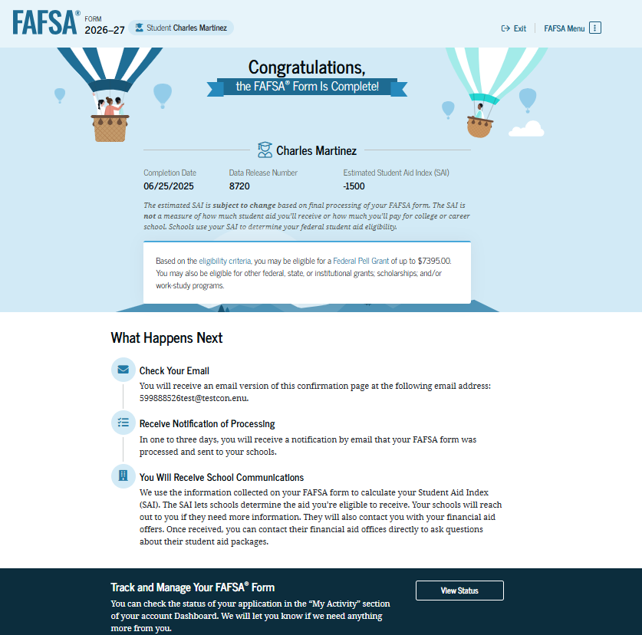
Add Schools: Confirmation
After the student has submitted the correction, they are presented with the confirmation page. This page displays information for the student about next steps, including tracking their FAFSA® form and correction.

